Slide 1
UML (Unified Modeling Language) Diagrams
Software Engineering
Neil Toporski

Slide 2
1 UML Diagrams [Outline]
UML Diagram Type
Use Case Diagrams
Class Diagrams
Sequence Diagrams

Slide 3
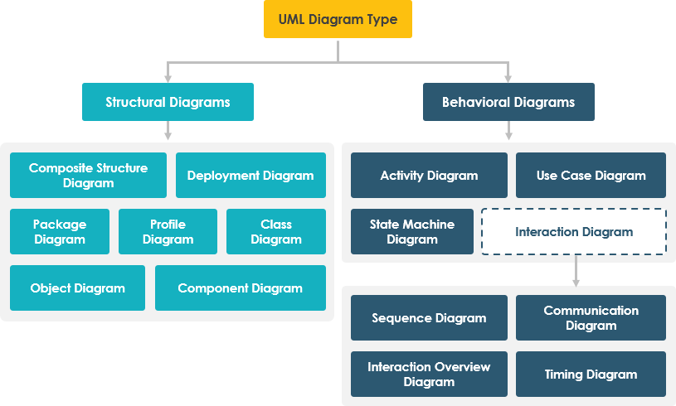

1.1 UML Diagram Type

Slide 4
1.2 Use Case Diagrams
Purpose
Use case diagrams are typically developed in the early stage of development and people often apply use case modeling for the following purposes:
Specify the context of a system
Capture the requirements of a system
Validate a systems architecture
Drive implementation and generate test cases
Developed by analysts together with domain experts

Slide 5
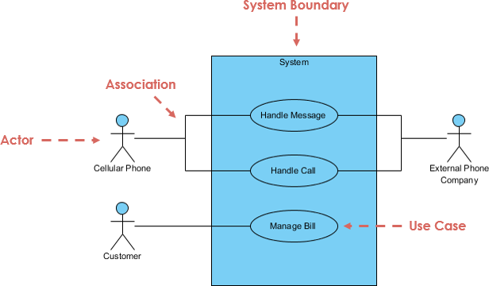
Parts of Use Case Diagrams
Actors
System
Associations

Slide 6
Parts of Use Case Diagrams
Actor
Someone interacts with use case (system function). Resides outside the system.
Named by noun. (Type or Categories: Customer not “John”)
Actor plays a role in the business
Similar to the concept of user, but a user can play different roles
Actor triggers use case(s).
Actor has a responsibility toward the system (inputs), and Actor has expectations from the system (outputs).

Slide 7
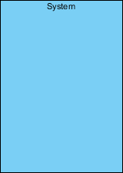
Parts of Use Case Diagrams
Actors
Primary: Initiates the use of the system. i.e. The customer.
Secondary: More reactionary. i.e. the Bank acts only once the customer does something.
Primary actors should be on the left of the system whereas secondary actors should be on the right.
Customer
Bank

Slide 8

Parts of Use Case Diagrams
Use Case
System function (process - automated or manual)
Named by verb + Noun (or Noun Phrase).
i.e. Do something
Each Actor must be linked to a use case, while some use cases may not be linked to actors.

Slide 9

Parts of Use Case Diagrams
Communication Link (Associations)
The participation of an actor in a use case is shown by connecting an actor to a use case by a solid link.
Actors may be connected to use cases by associations, indicating that the actor and the use case communicate with one another using messages.
Association Link:

Slide 10
Parts of Use Case Diagrams
System: Whatever you are developing.
Boundary of System
The system boundary is potentially the entire system as defined in the requirements document.
For large and complex systems, each module may be the system boundary.
For example, for an ERP system for an organization, each of the modules such as personnel, payroll, accounting, etc.
can form a system boundary for use cases specific to each of these business functions.
The entire system can span all of these modules depicting the overall system boundary.

Slide 11


Structuring Use Case Diagram with Relationships
Extends:
A behavior extends another if it is in addition to but not necessarily part of the behavior.
Include:
The include relationship adds additional functionality not specified in the base use case. The <<Include>> relationship is used to include common behavior from an included use case into a base use case in order to support the reuse of common behavior.

Slide 12
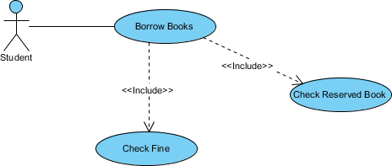
Include Relationship

Slide 13

Extend Relationship
In this case, The <<extend>> relationship is used to include optional behavior from an extending use case in an extended use case.

Slide 14
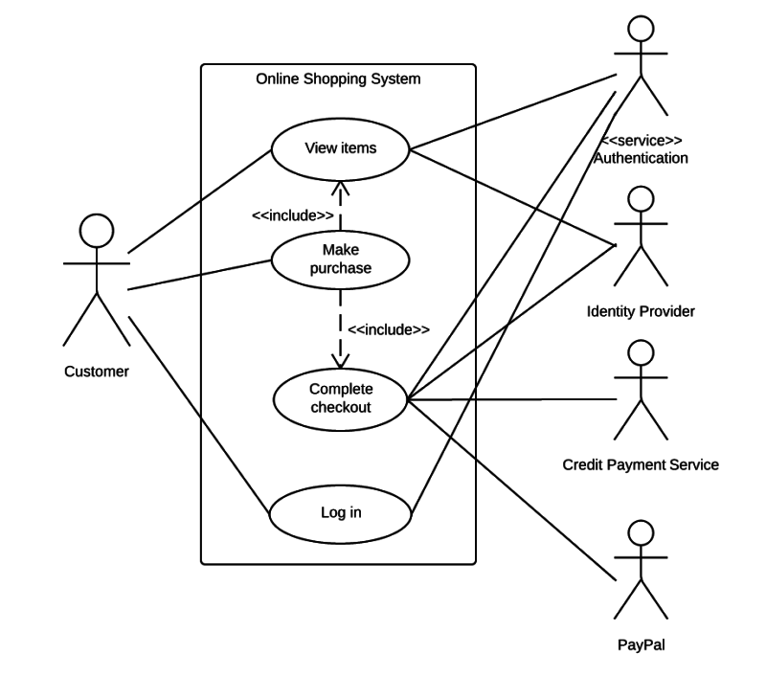
Online Shopping

Slide 15
Tryit
A bank customer
Opens an account or
Deposit funds or
Withdraw funds
Balance is updated when customer
Deposit funds or
Withdraw funds

Slide 16
1.3 Class Diagrams
What is a Class?
A Class is a blueprint for an object. Objects and classes go hand in hand. We can't talk about one without talking about the other. And the entire point of Object-Oriented Design is not about objects, it's about classes, because we use classes to create objects. So, a class describes what an object will be, but it isn't the object itself.

Slide 17
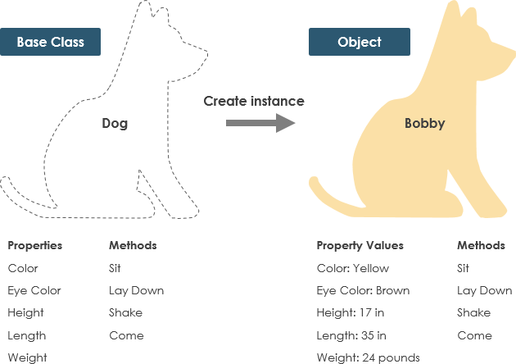
Example: Dog
A dog has states - color, name, breed as well as behaviors -wagging, barking, eating. An object is an instance of a class.

Slide 18
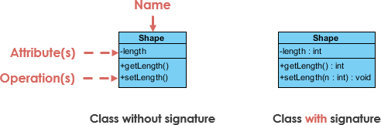
Class Notation
A class represent a concept which encapsulates state (attributes) and behavior (operations). Each attribute has a type. Each operation has a signature. The class name is the only mandatory information.

Slide 19
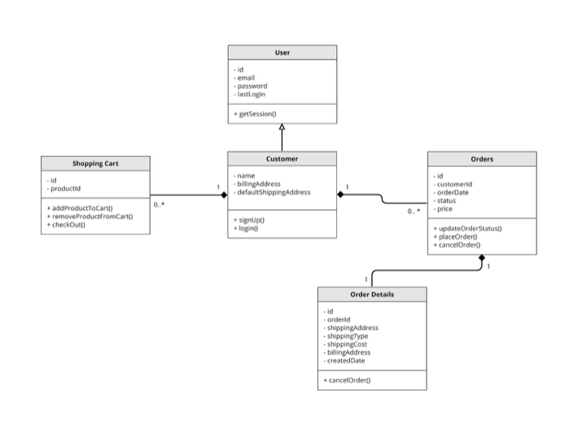
Class Notation
Class diagrams have three main constituents:
Class Name - this is a mandatory section as it contains the name of the class
Class Attributes - this is where all the attributes of a class can be found. (fields, variables, properties)
Class Operations - includes a list of operations that describe how a class interacts with data.

Slide 20
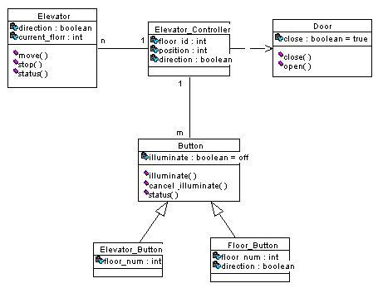
Class Diagram Example: Elevator

Slide 21

Video: More on UML Class Diagrams

Slide 22
1.4 Sequence Diagrams
Sequence Diagrams captures:
The interaction that takes place in a collaboration that either realizes a use case or an operation (instance diagrams or generic diagrams).
High-level interactions between user of the system and the system, between the system and other systems, or between subsystems (sometimes known as system sequence diagrams).
Sequence Diagrams show elements as they interact over time and they are organized according to object (horizontally) and time (vertically).

Slide 23
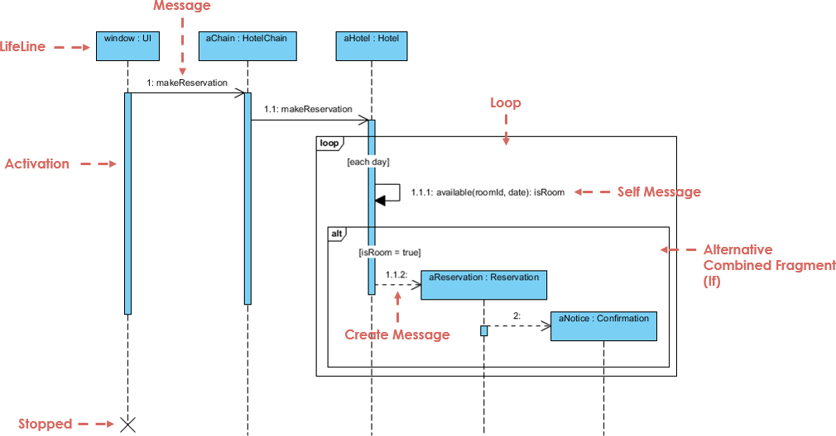
Sequence Diagrams

Slide 24
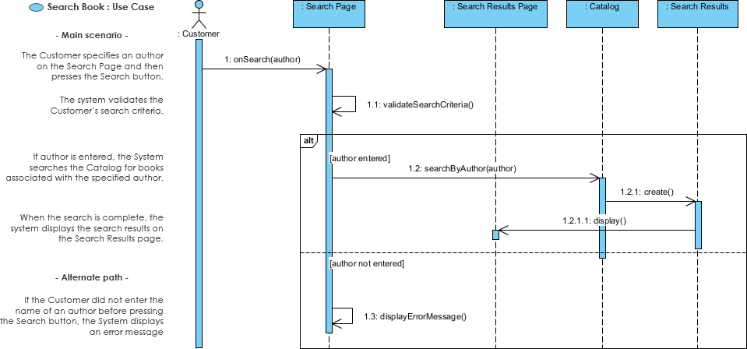
Sequence Diagrams

Slide 25

Sequence Diagrams

Slide 26
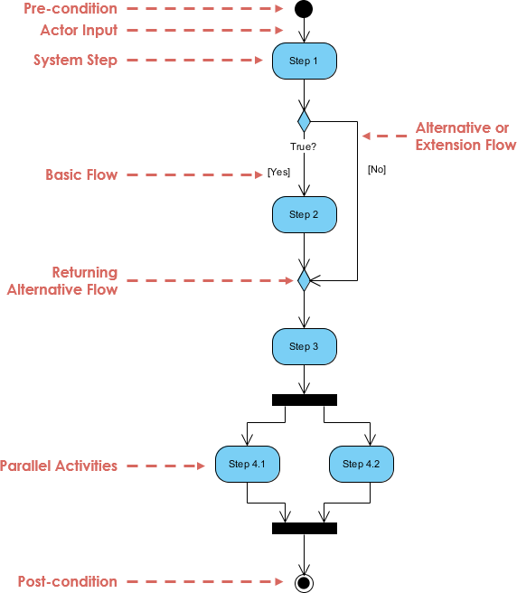
1.5 Activity Diagrams
Activity Diagrams describe how activities are coordinated to provide a service which can be at different levels of abstraction.
Identify candidate use cases, through the examination of business workflows
Identify pre- and post-conditions (the context) for use cases
Model workflows between/within use cases
Model complex workflows in operations on objects
Model in detail complex activities in a high level activity Diagram

Slide 27
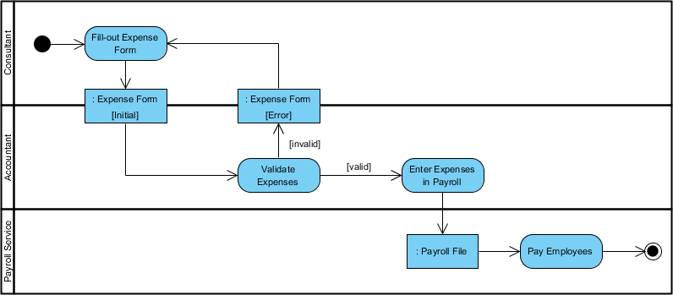
Activity Diagrams: Staff Expenses Submission

Slide 28
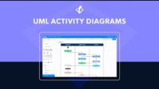
Activity Diagrams

